Slide 1

Training - QC Planning

Slide 2
Agenda
Test Plan Definition
Planning Documents
  Test Strategy
  Test Plan
IEEE Test Plan Template
Globant Test Plan Template

Slide 3
Test Planning
Test Planning:
During the Test Planning we make sure we understand the goals and objectives of the customers, stakeholders, the project, and the risks which testing is intended to address.
Based on this understanding, we set the goals for the testing itself, and derive an approach and plan for the tests, including specification of test activities.
Test Planning happens before coding and test creation.

Slide 4
Process of Planning
CONSIGNEE
WHO? / For Whom?
EVALUATION
Did it work? (Strengths / Areas to Develop)
KNOKLEDGE
WHAT?
GOAL
For what purpose?
STAGES / Steps
WHEN? / In What Order?
ESTRATEGY
HOW?
RESOURCES
WITH WHAT?

Slide 5
Planning
It bridges between Where we are and Where we want to go
A plan should be a realistic view of the expectations
Depending upon the activities, a plan can be long range, intermediate range or short range
Preparation of a comprehensive plan will not guarantee success, but lack of a plan will almost certainly ensure failure

Slide 6
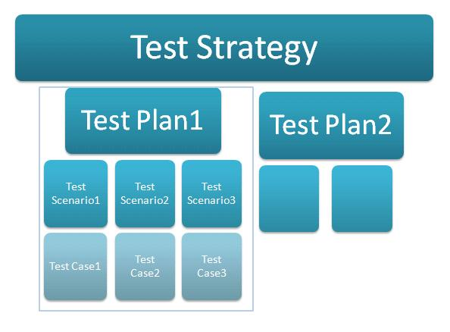
Planning Management Documents
Notes:
Test Scenario
High level description of the test case.
Test Cases
A test case is an extension of the "test scenario" explaining in detail the steps involved with expected result for each

Slide 7

Test Strategy
“Test Strategy" document talks about the high level testing approach not going to the details of the plan.
This document acts as an umbrella for all the test plans generated for that particular project or initiative , in some cases a single strategy document is created for the entire organization

Slide 8
Test Strategy
A test strategy can provide various details on the test process. It might discuss the following areas:
Risks and Mitigation
The integration procedures, such as top-down, bottom-up, functional, or risk-based
Roles and Responsibilities
Test Levels and methods of execution
Environment Requirements
Test Control and Reporting
How incident management is to be performed
The relationship and communication between the testing group and other groups on the project
The deliverables that flow between those groups

Slide 9

Test Plan
"Test Plan" is a document detailing the plan for testing for the chosen feature/project. A Test plan usually talks about : feature,high level architecture details, different types of testing conducted, list of scenarios etc.
Level of information provided in the test plan depends on the SDLC model (waterfall or agile), type of project and the requirements of the team.
The important part of the test planning process is for the tester to think through the testing, document and communicate so he gets feedback early

Slide 10
Test Plan
Test Plan also called Project Test Plan
This document includes:
What is the change about?
Where are the changes made in the architecture?
How is your testing planned?
Timelines & Logistics

Slide 11
Test Plan
There are different definitions of what goes in a Test Plan, for us
A Test Plan is the project plan for the testing work to be done.
A Test Plan IS NOT;
Why do we write Test Plans?
First of all, guides our thinking
Forces us to confront the challenges that await and focus our thinking on important things
Serve as a vehicle for communicating with other members of the project team (testers, managers, other stakeholders, developers, etc)
A Test Design Specification
A Set of Test Procedures
A Collection of Test Cases

Slide 12
Test Plan
Following are the major tasks which help us build a Test Plan:
Determine the scope and risks
Identify the objectives of testing
Determine the test approach
Implement the test strategy if it is necessary
Determine the required test resources (people, environments, tools)
Schedule test activities (analysis and design, test implementation, execution and evaluation)
Determine the entry and exit criteria
Decide how to split into various levels reducing the gaps and overlaps
Test planning takes into account the feedback from monitoring and control activities which take place throughout the project to apply adjustments

Slide 13
Conclusions
Planning in advance will provide a number of benefits:
Early discovery and management of risks
Coordinate with others who will participate in the project, ensuring that everyone knows their part when the time comes.
Is a useful road map for the work to come.
We can often detect quality risks and problems before test execution, such as missing information about performance and reliability in the product requirements.
We can often identify problems in project plans and other project work products, such as missing skills in the project team in specialized areas.
Might identify opportunities to adjust the test staff, budget, effort, or duration to better balance quality priorities against features schedule and budget constraints.
Identify critical components, such as servers or databases or central software elements.

Slide 14
Conclusions (cont.)
Are you a bad test manager if you don’t have all documents, addressing exactly the topics described?
Definitely NO!!!
You can combine these documents into one document or spread in information across multiple documents. In some cases you might not document this information at all, though that’s a risky approach for all but the smallest, shortest, and most transient projects.

Slide 15
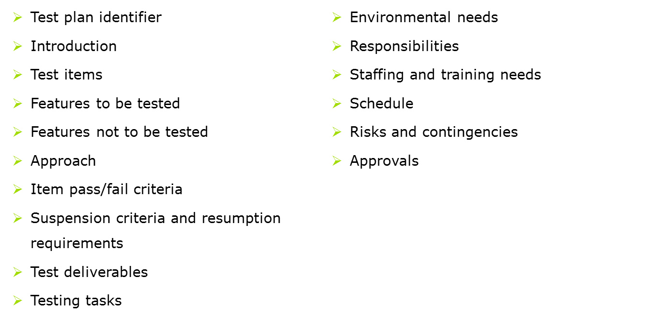
IEEE 829 Standard Test plan Template
Is an IEEE standard that specifies the form of a set of documents for use in defined stages of software testing and define the following items for the Test Plan:

Slide 16
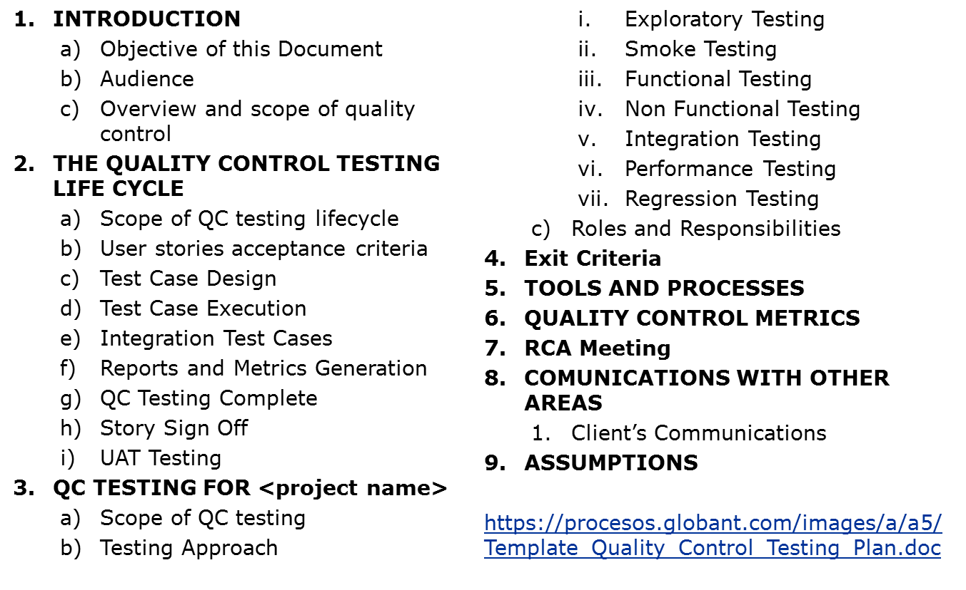
Globant Test plan Template

